Slide 1
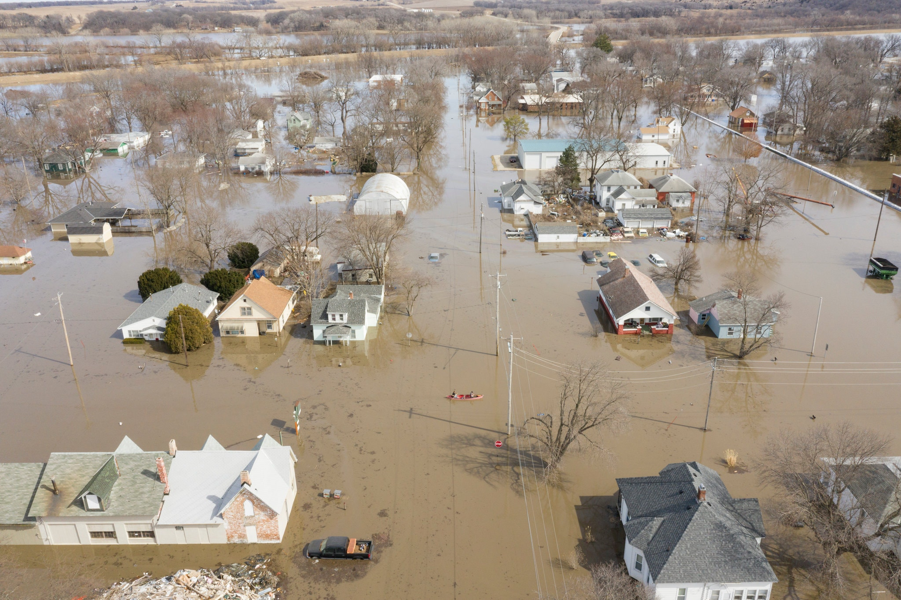
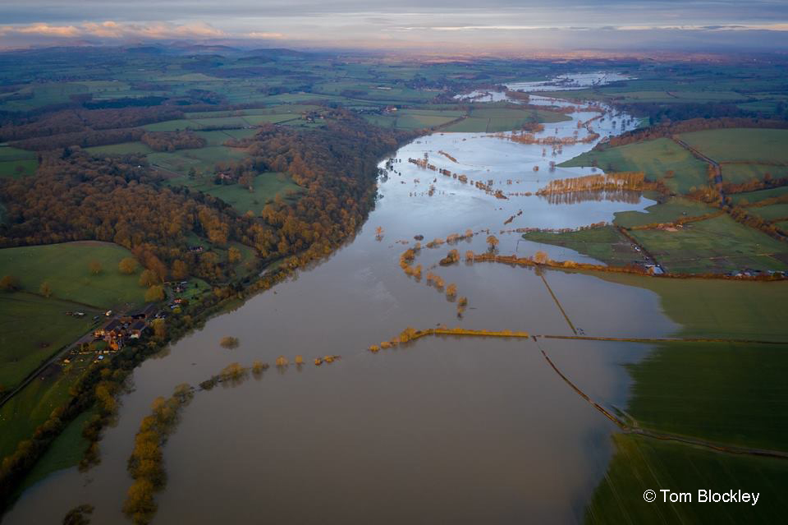
Flooding
Jessica Marggraf

Slide 2
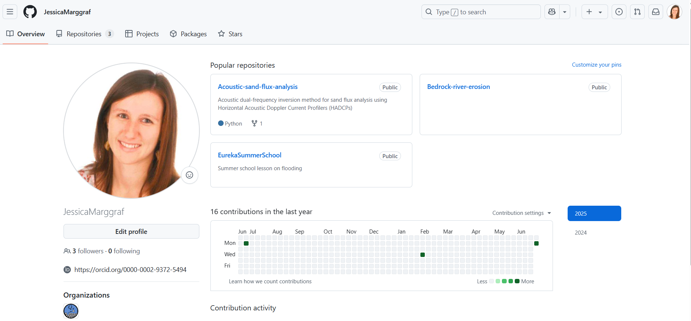
Get the slides and the handout online!
Go to my (Jessica Marggraf) Github profile, then to Eureka Summer School (type “Jessica Marggraf github”)
Download the files of interest

Slide 3
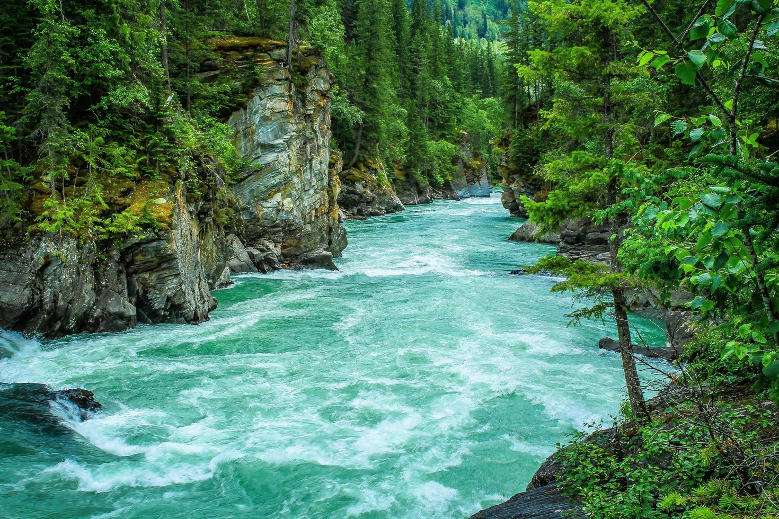
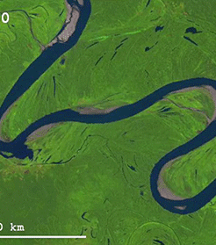
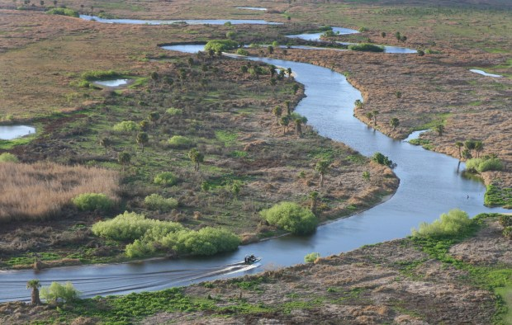
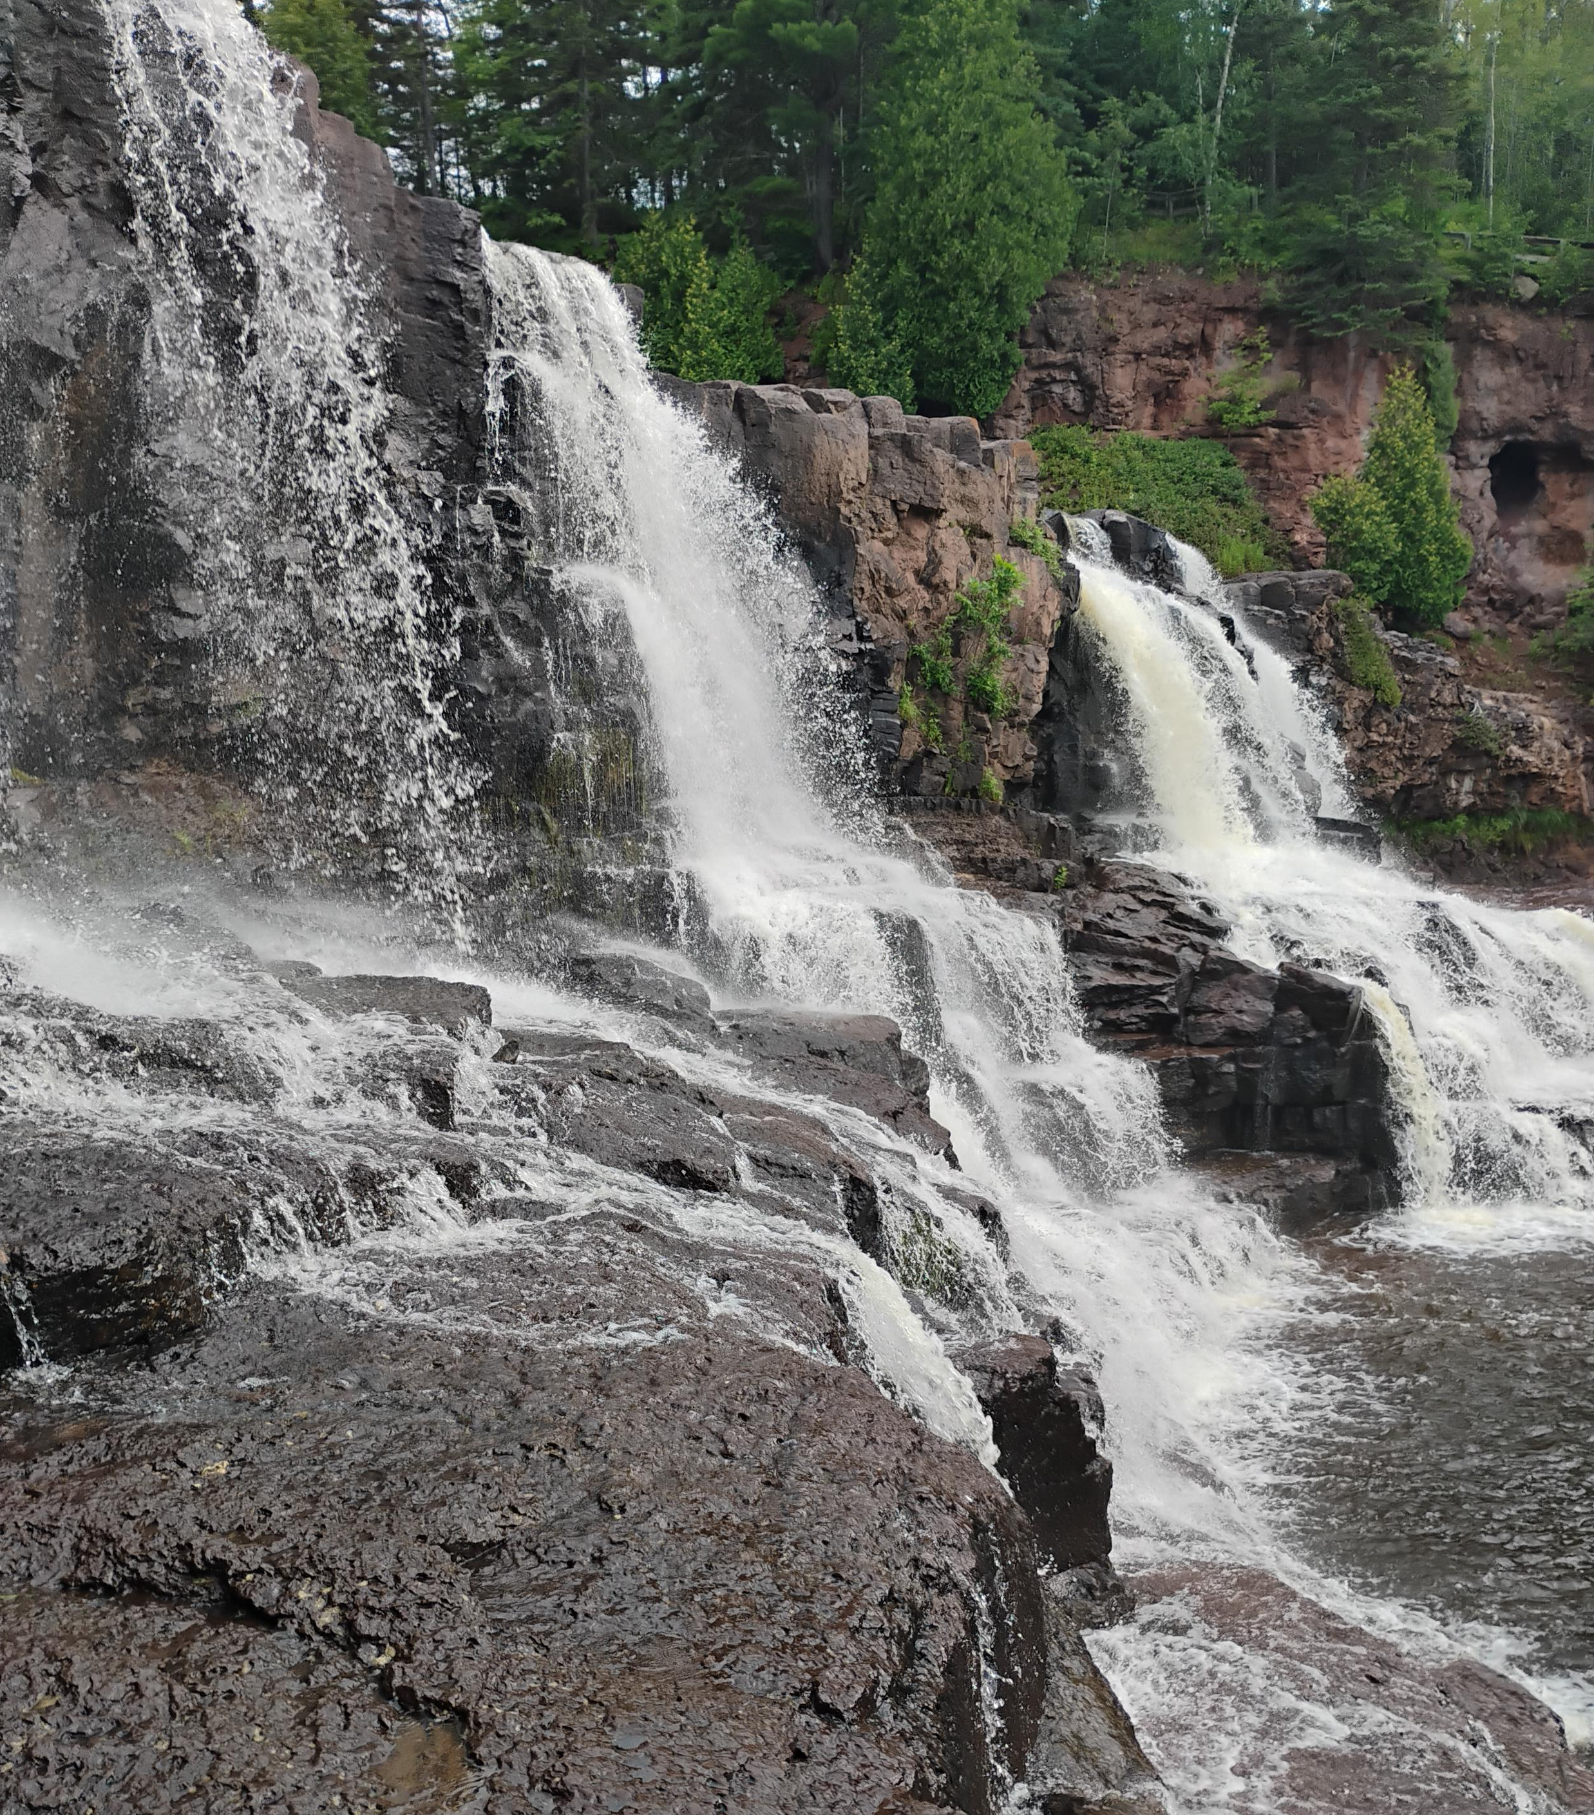
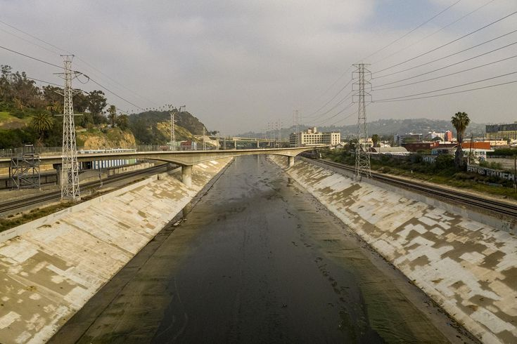
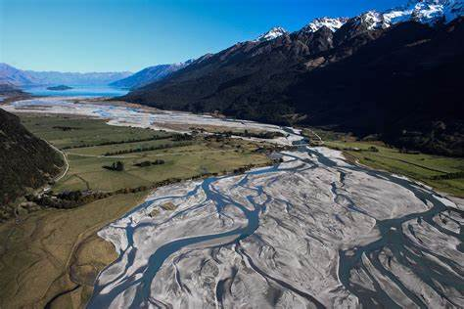
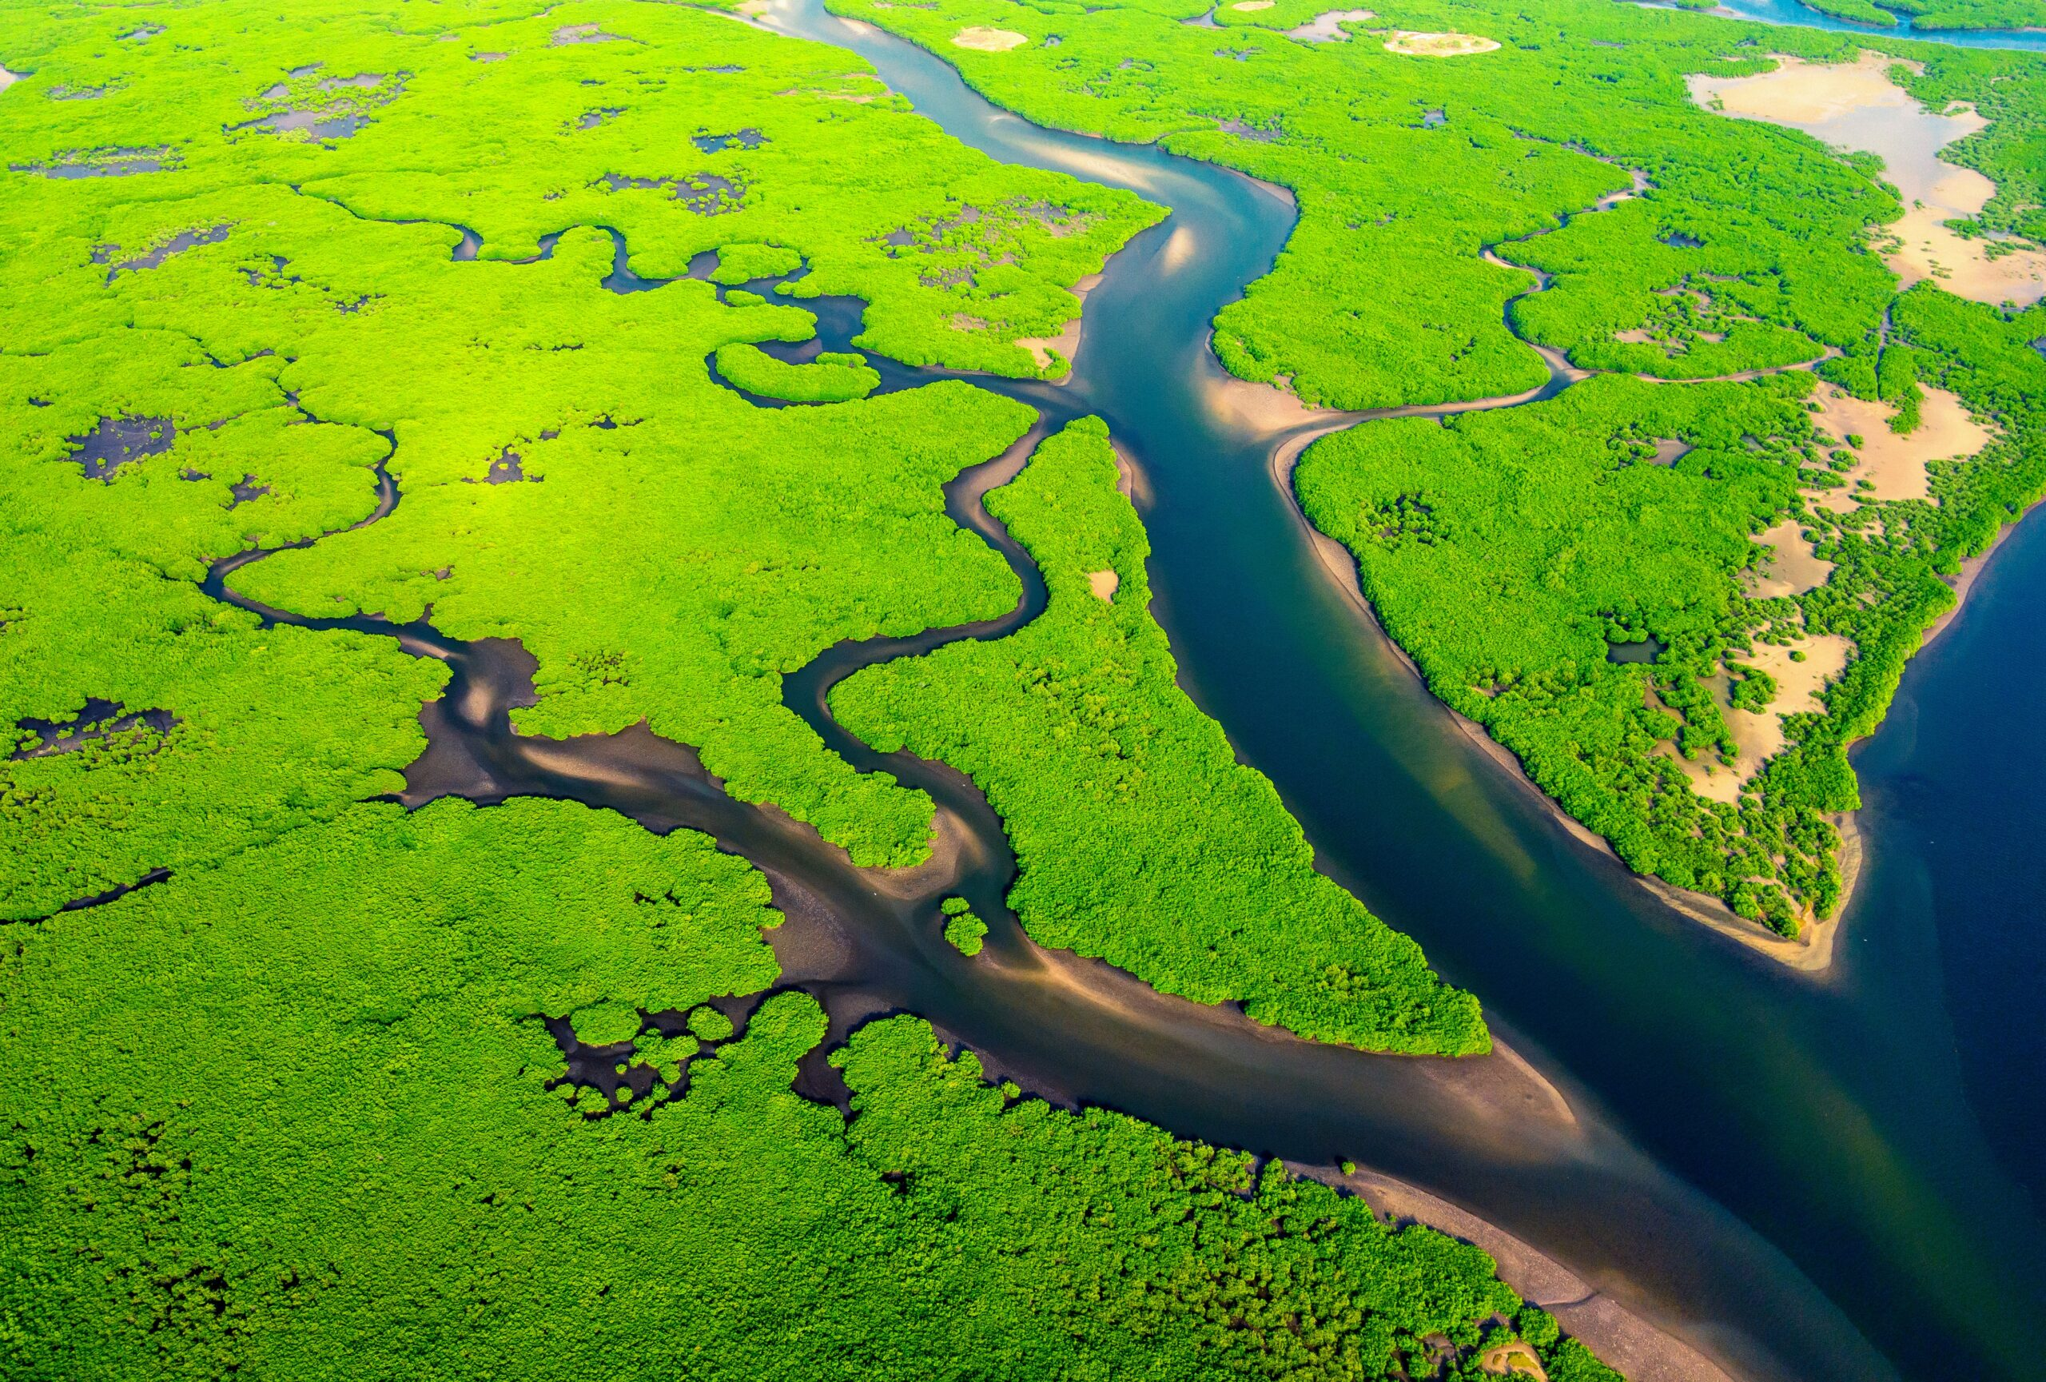
Rivers are very diverse landscape features!

Slide 4
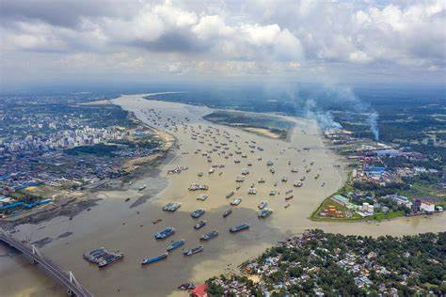
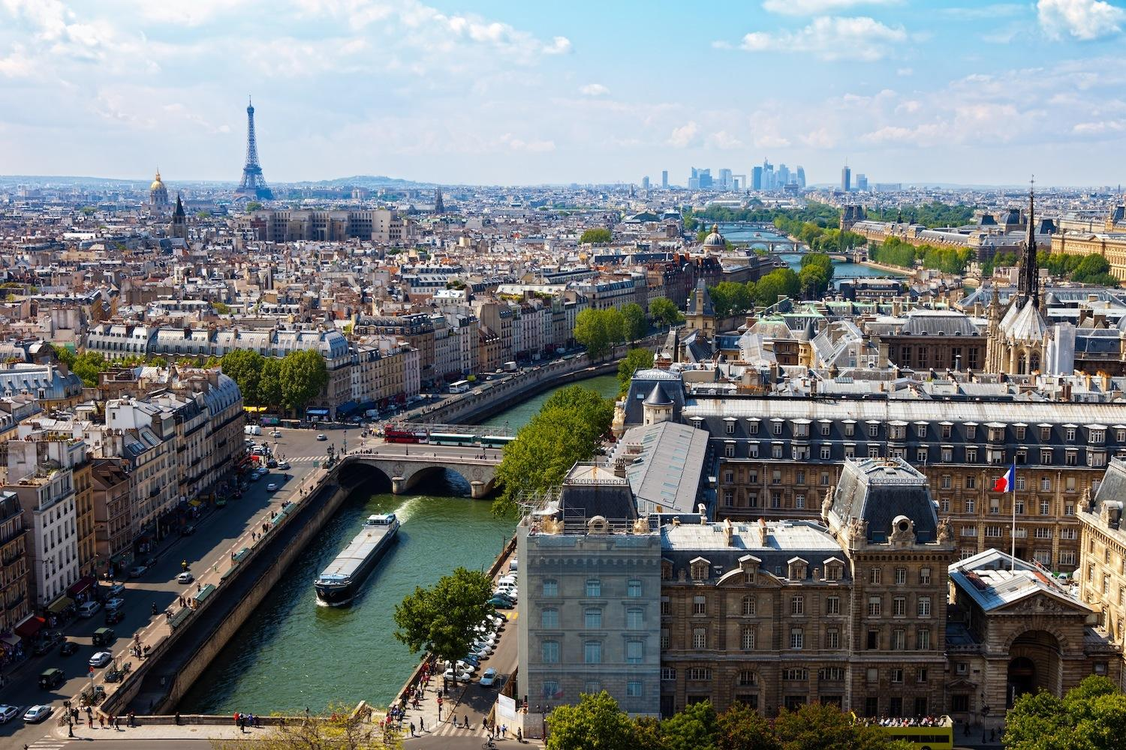
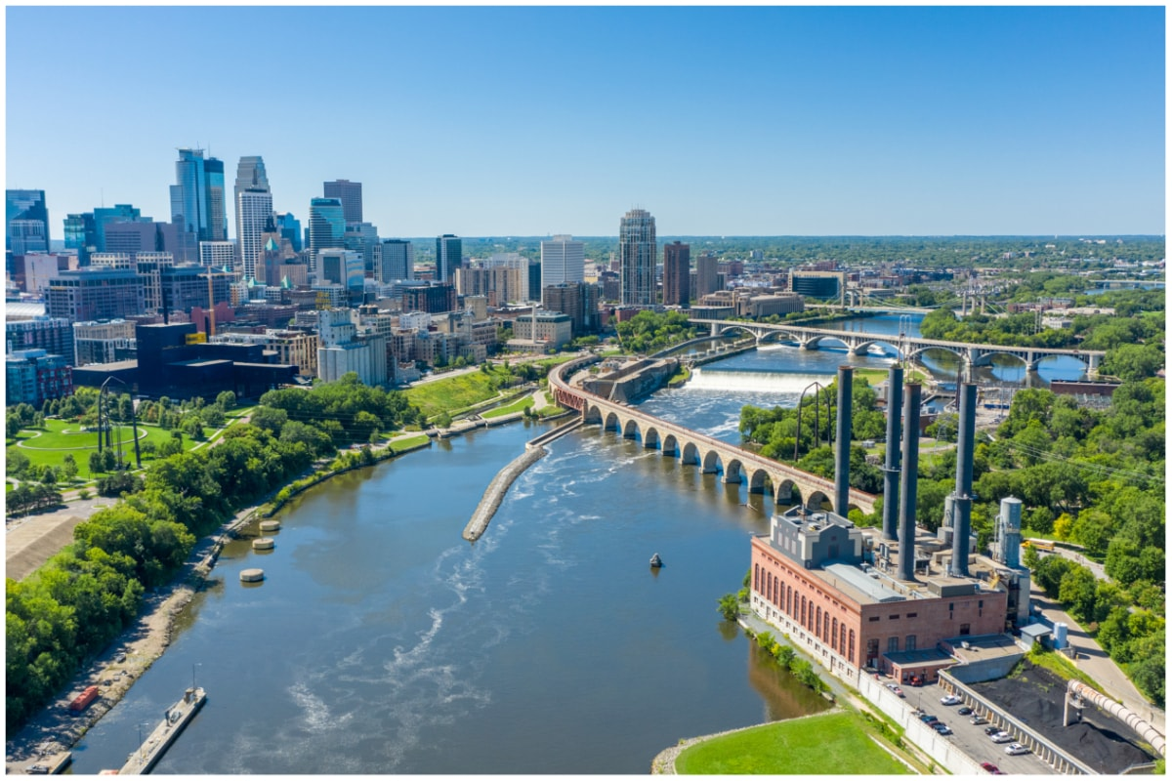
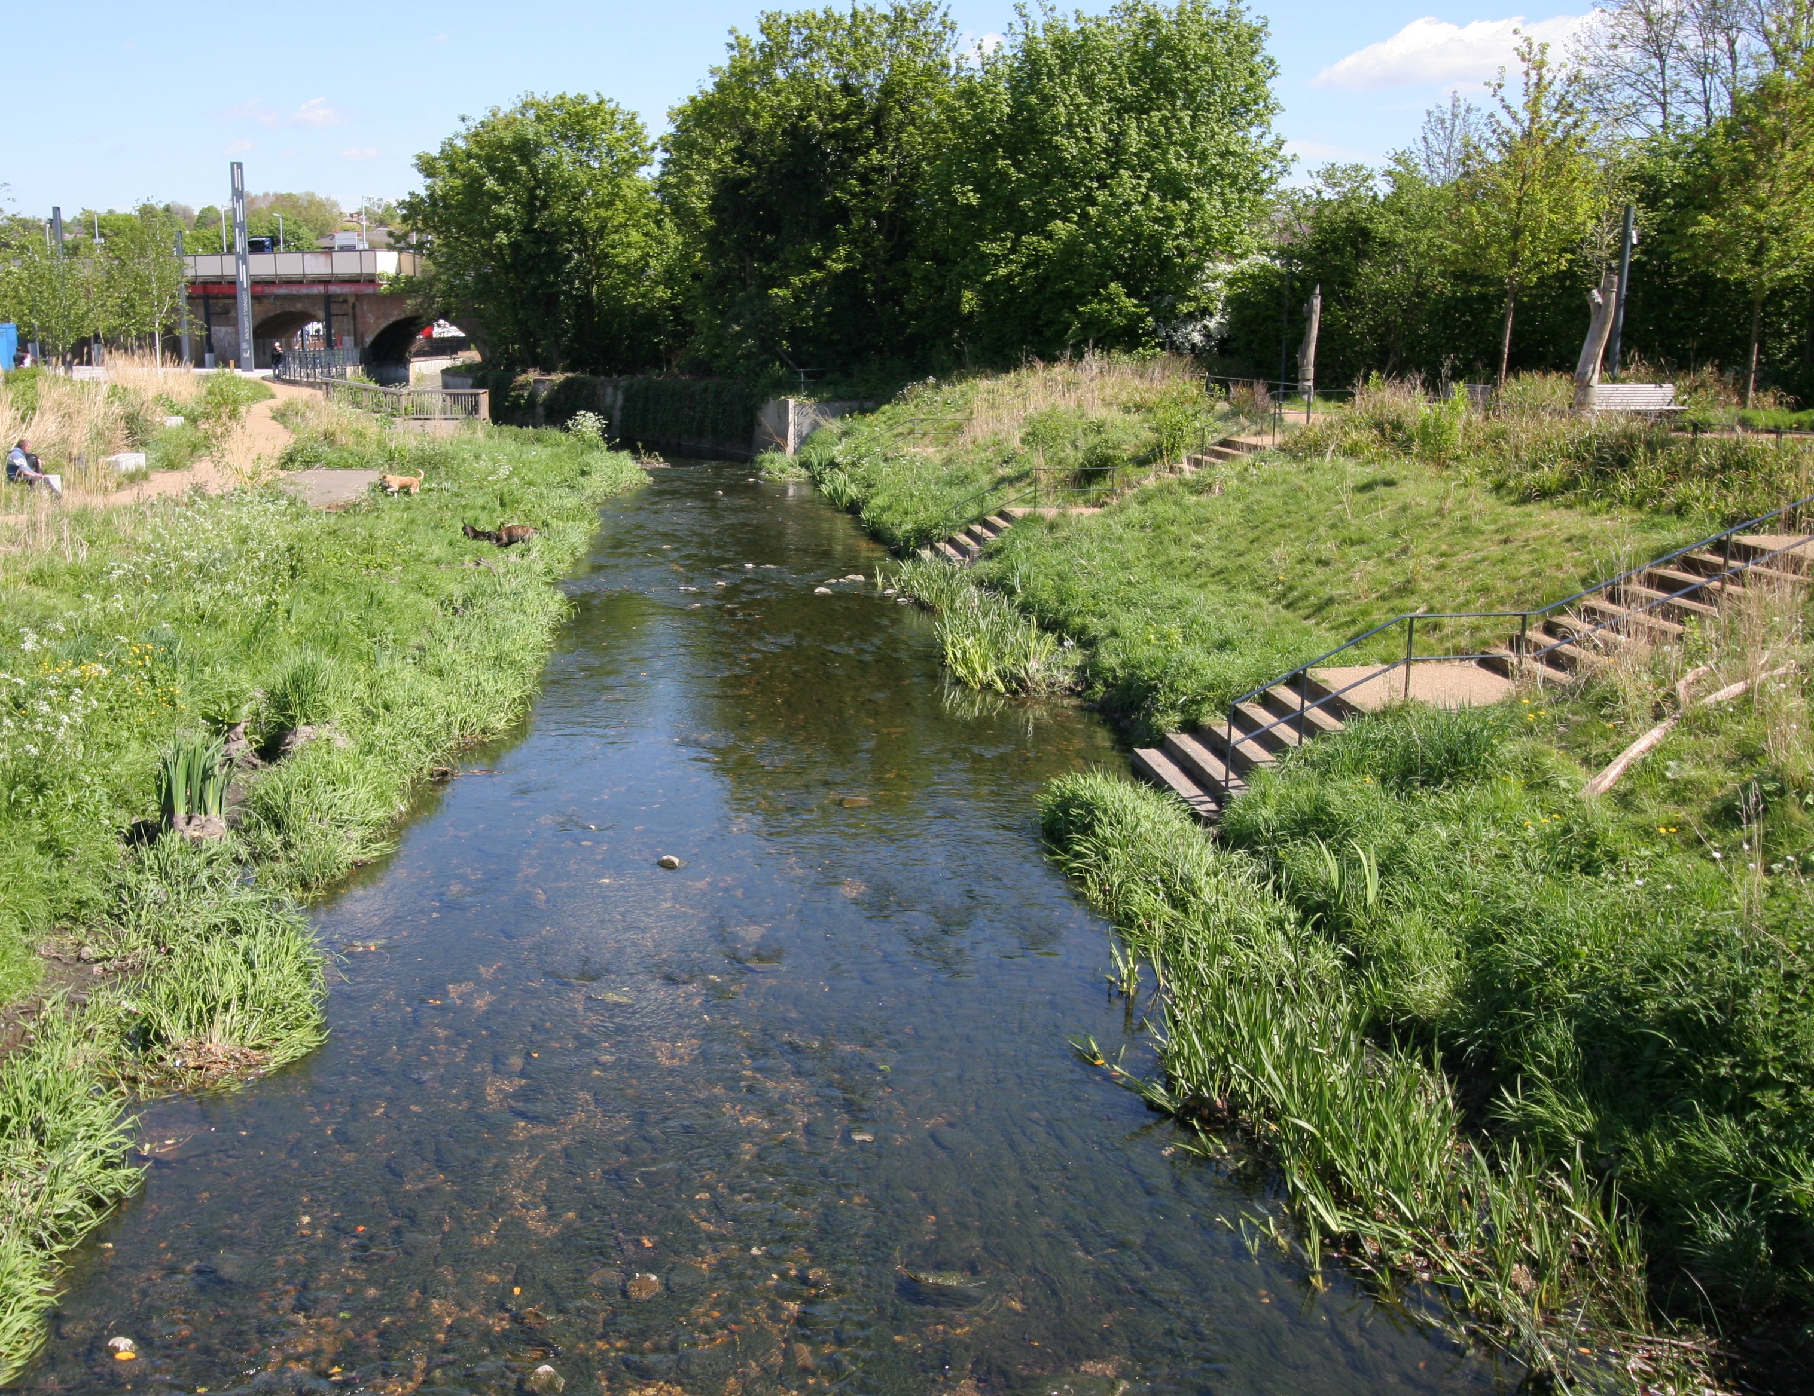
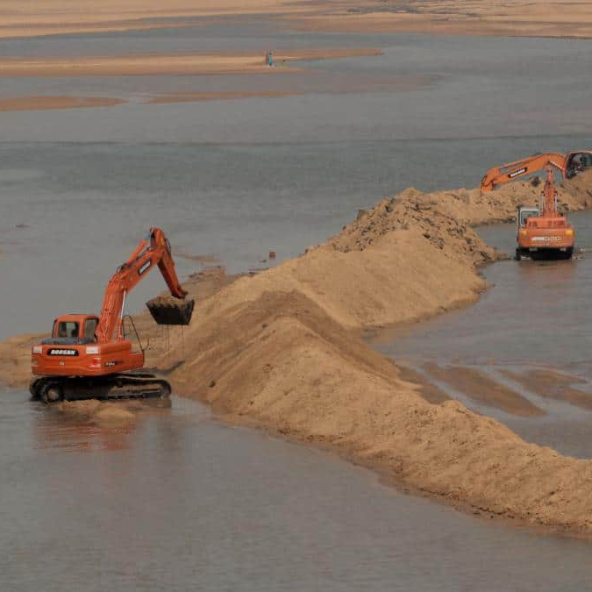
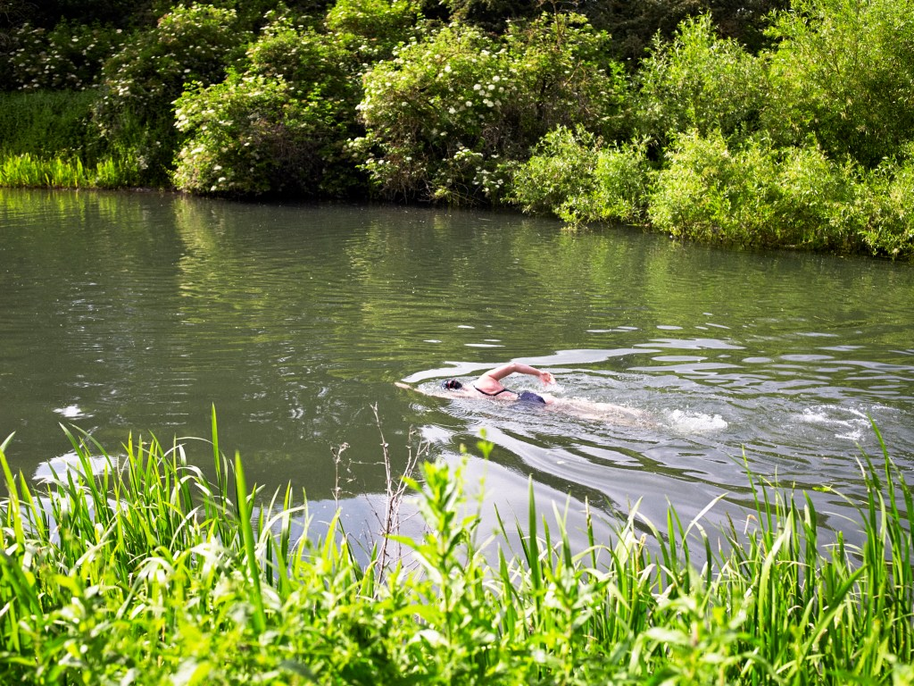
We humans like to live near water – for many reasons!

Slide 5
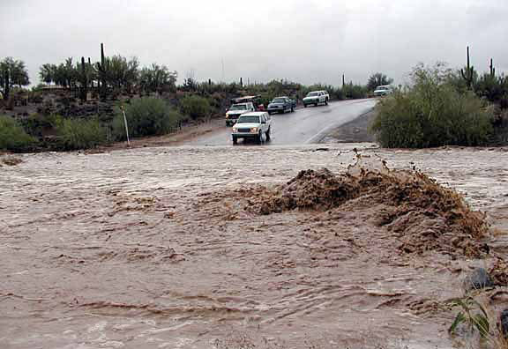
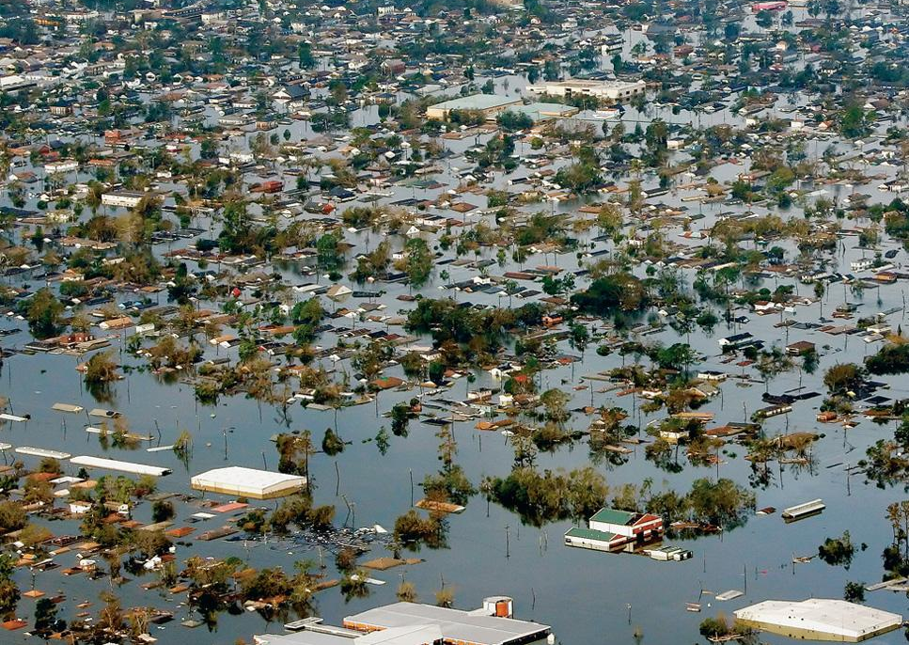
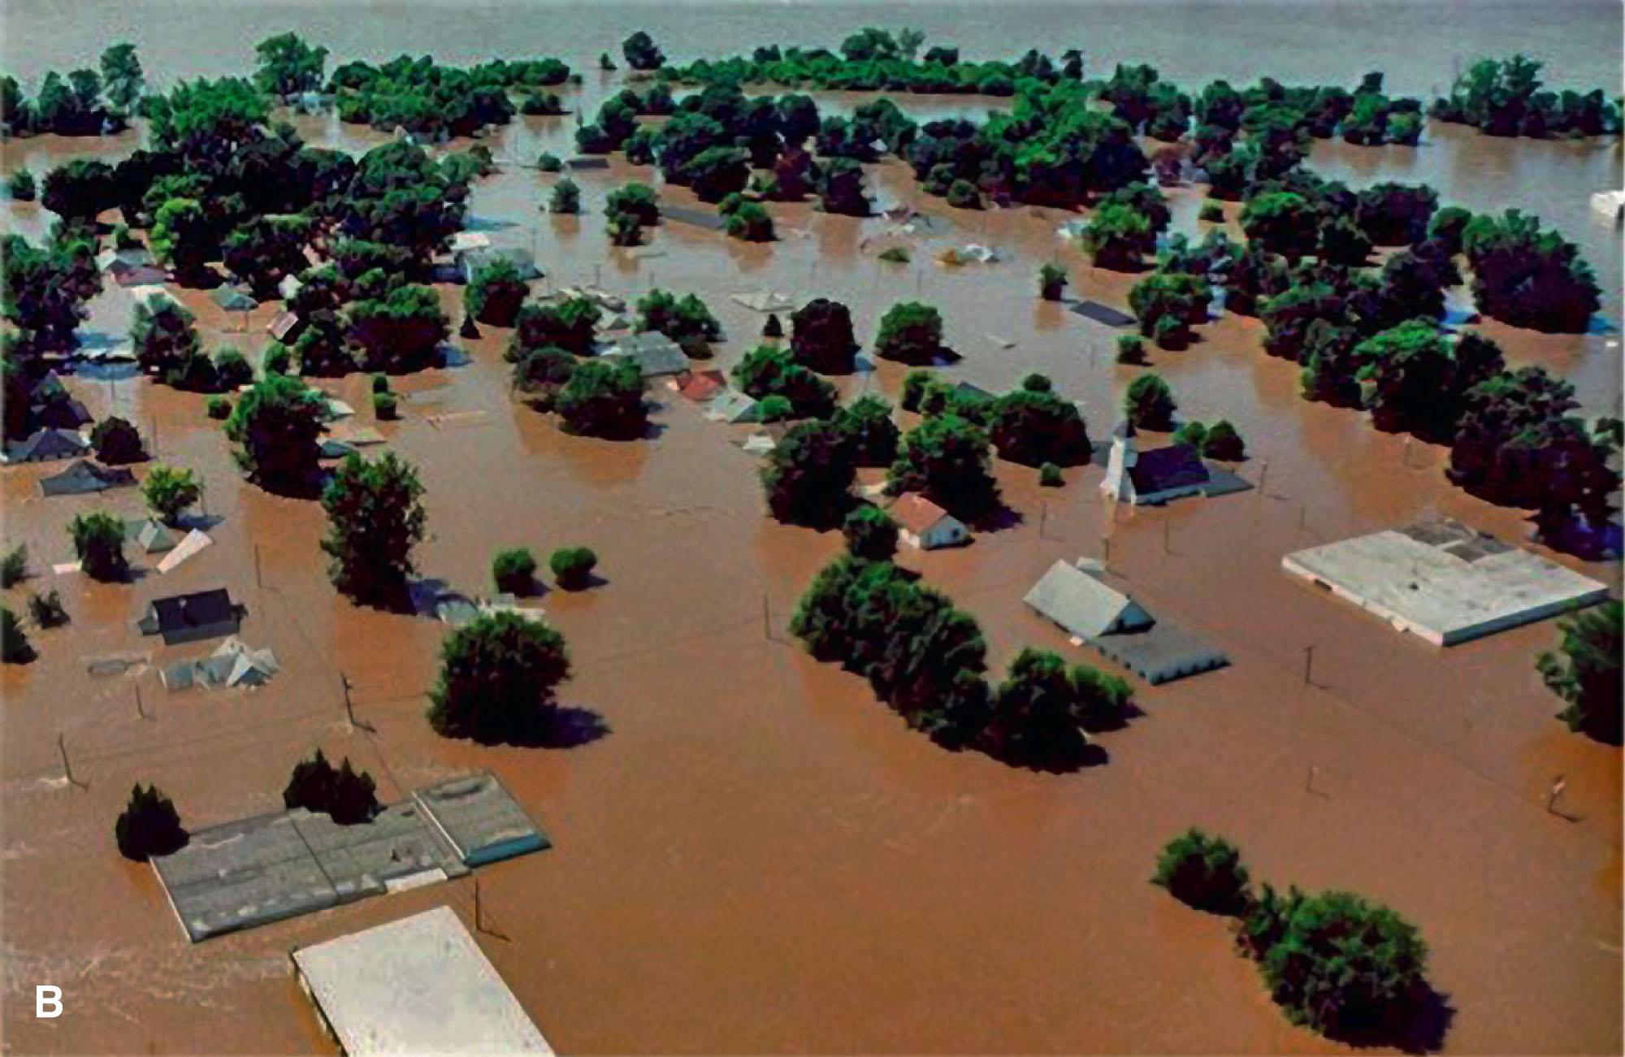
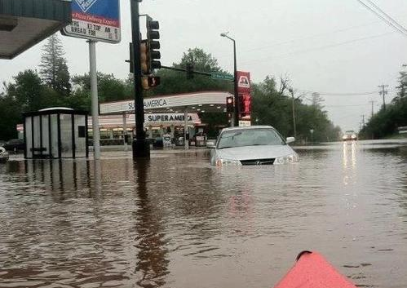
Flooding
Living close to rivers makes us vulnerable to their natural variations

Slide 6
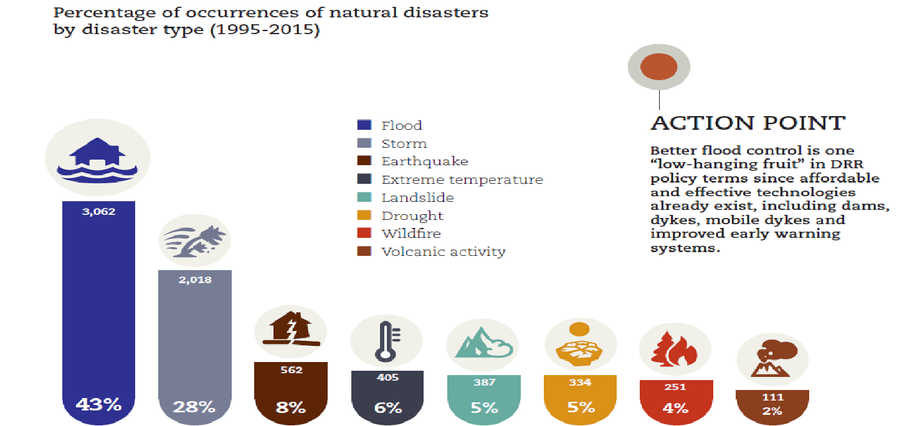
Flooding is common
Percentage of occurrences of natural disasters worldwide by disaster type (1995-2015)
Notes:
The data show that 1.81 billion people (23% of the world population) are directly exposed to 1-in-100-year floods. The vast majority (89%) of these people live in low- and middle-income countries.
https://www.ncbi.nlm.nih.gov/pmc/articles/PMC9239995/

Slide 7
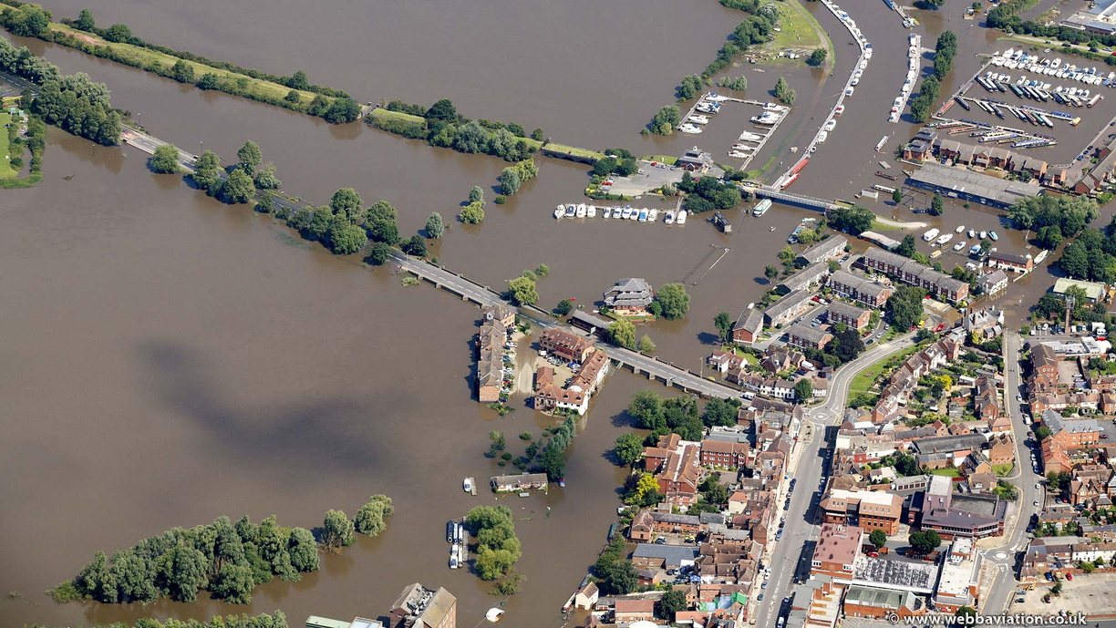
Part I – What is flooding and how can we describe it?

Slide 8
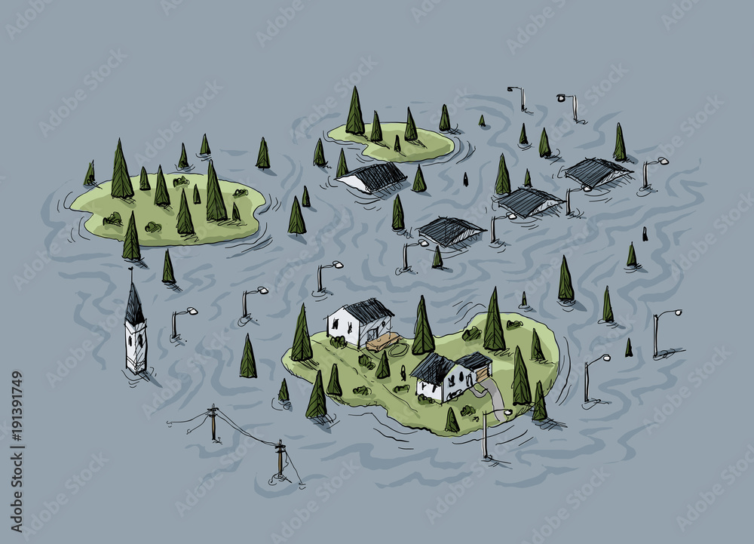
What is flooding?
Flooding is an overflowing of water onto land that is normally dry.
Flooding is part of natural river cycle.
Flooding is a short-term increase in water levels because of precipitation, melt water, runoff, and soil moisture

Slide 9
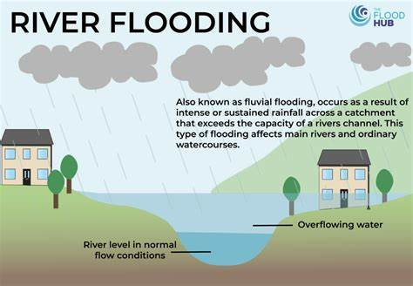
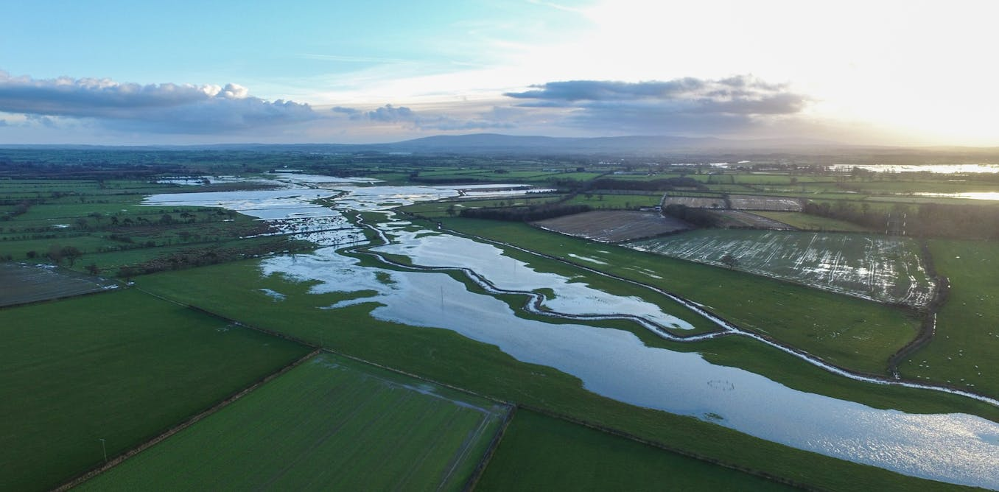
River flooding
Large rivers with low topography
High water inundating extensive region
Few deaths but extensive damage
→ Good forecasts possible

Slide 10
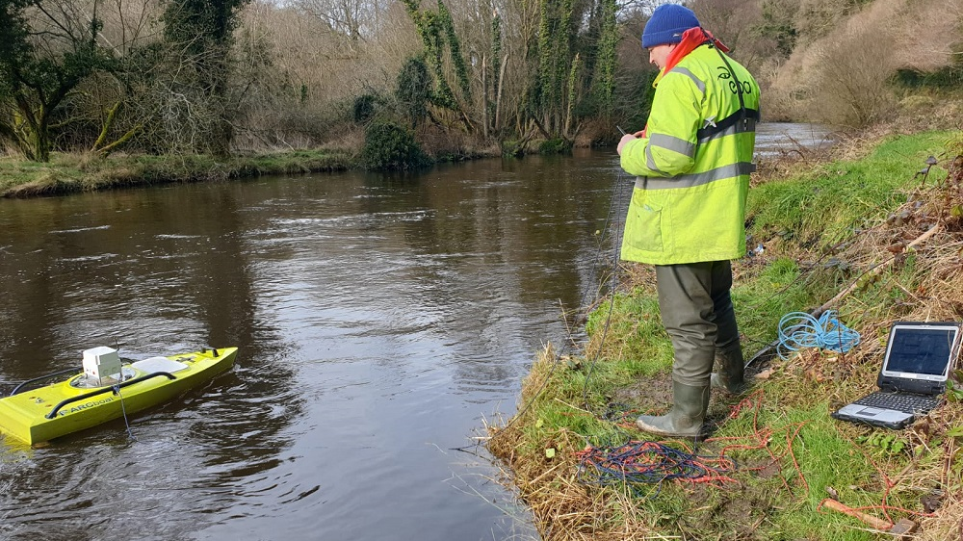
Part II – How do we measure flooding?

Slide 11
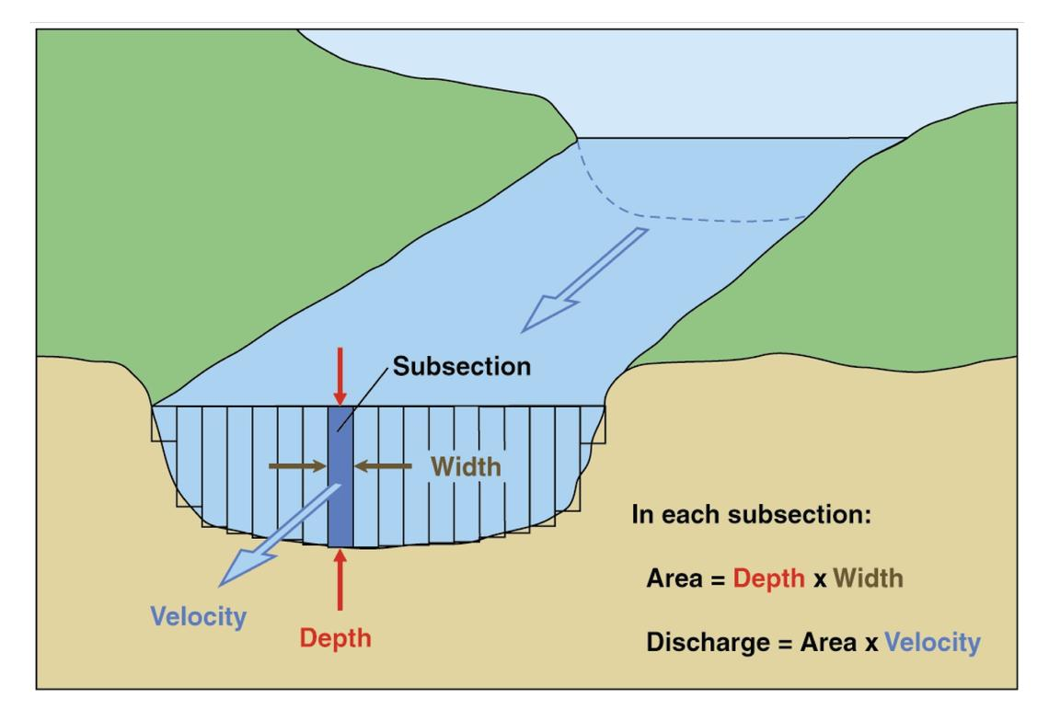
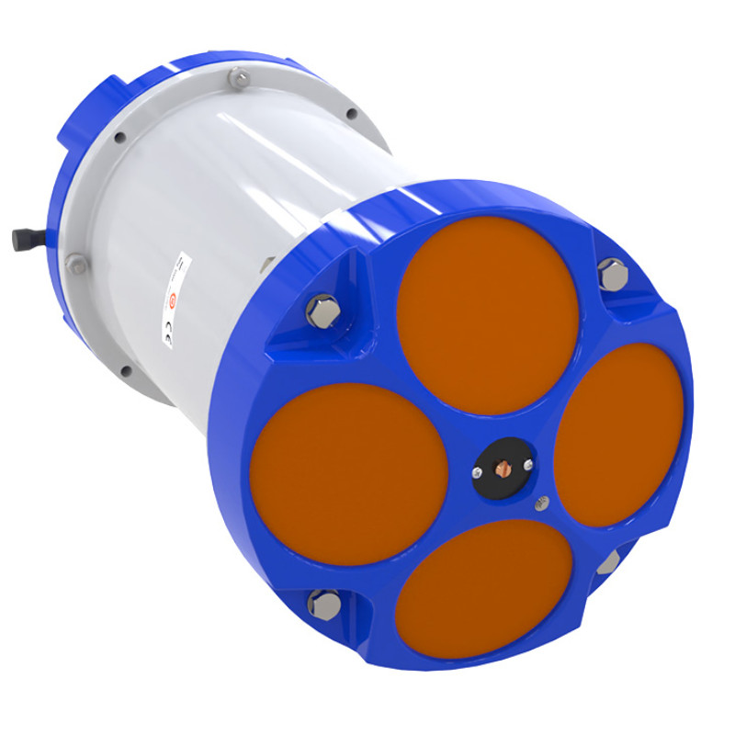
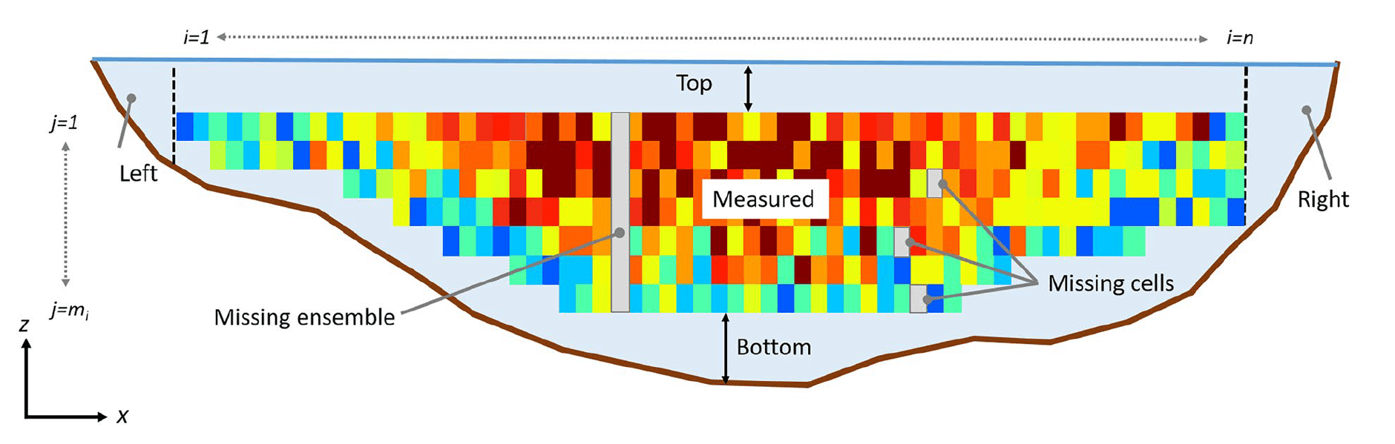
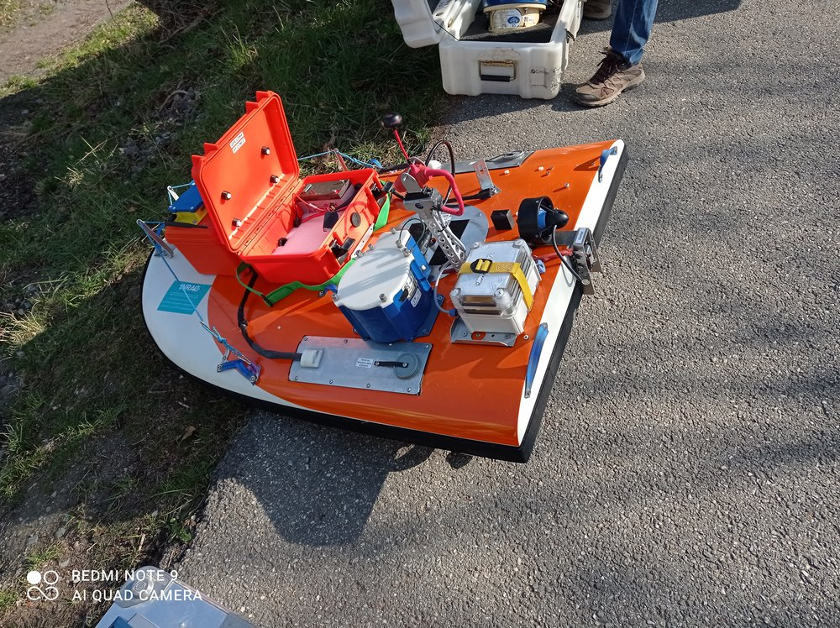
Stream flow =
River Discharge
Area =
Length²
The average volume of water flowing at a given point along the watershed is the discharge.
Velocity=
Length/time
A*V=
Length³/time
e.g. L
per sec

Slide 12
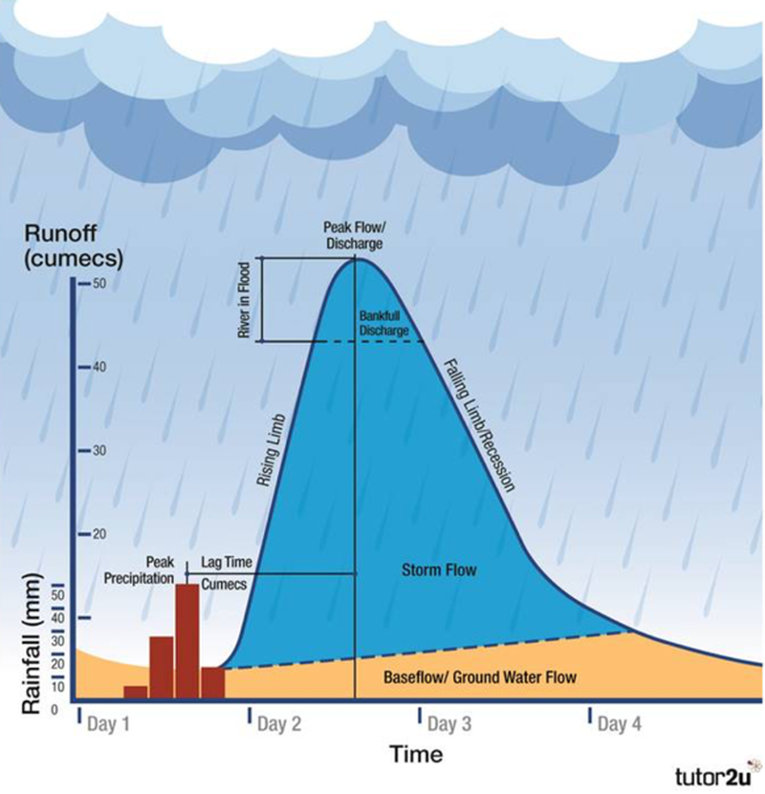
Hydrographs
A flood hydrograph
X axis is time
Y axis is streamflow or discharge
Baseflow is “normal” water level
Floods are big peaks or bumps above the baseflow

Slide 13
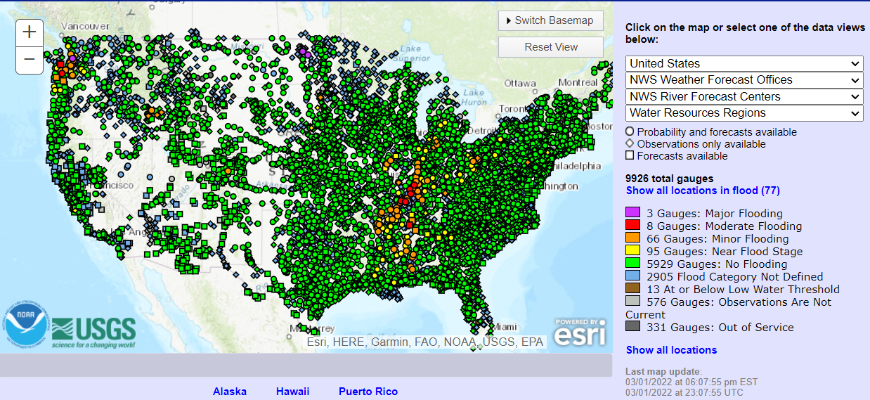
USGS stream gages – discharge measurements stations
Notes:
https://water.weather.gov/ahps/index.php

Slide 14


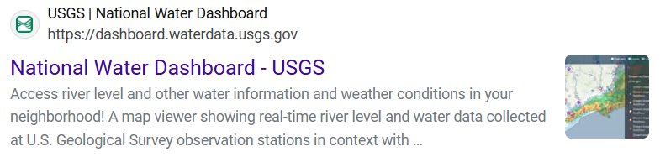
Explore the hydrograph of the Mississippi at St. Paul
Type the following in your favorite search engine “USGS national water dashboard river levels” to open the website of National Water Dashboard – USGS
→ See the handout for the full exercise!

Slide 15
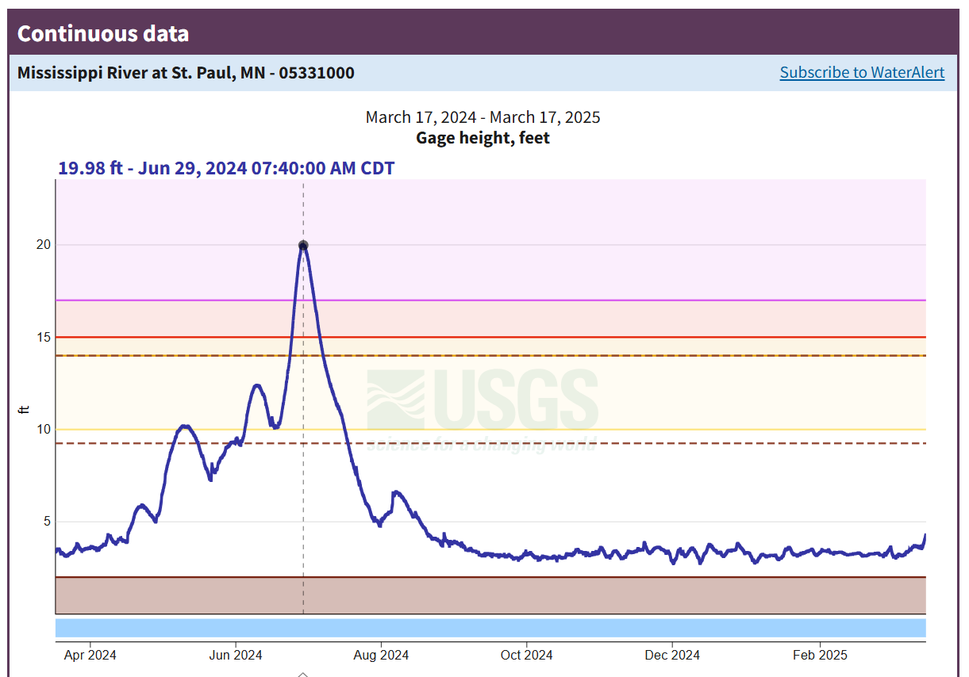
How do we categorize flooding?
Stage

Slide 16
Part III – How does flooding impact the environment and people?

Slide 17
Explore how communities were affected by floods
Use the “USGS Flood Inundation Mapper” (https://fim.wim.usgs.gov/fim/) to search for different locations and analyze how historical floods affected the communities in different ways.
→ See the handout for the full exercise!

Slide 18
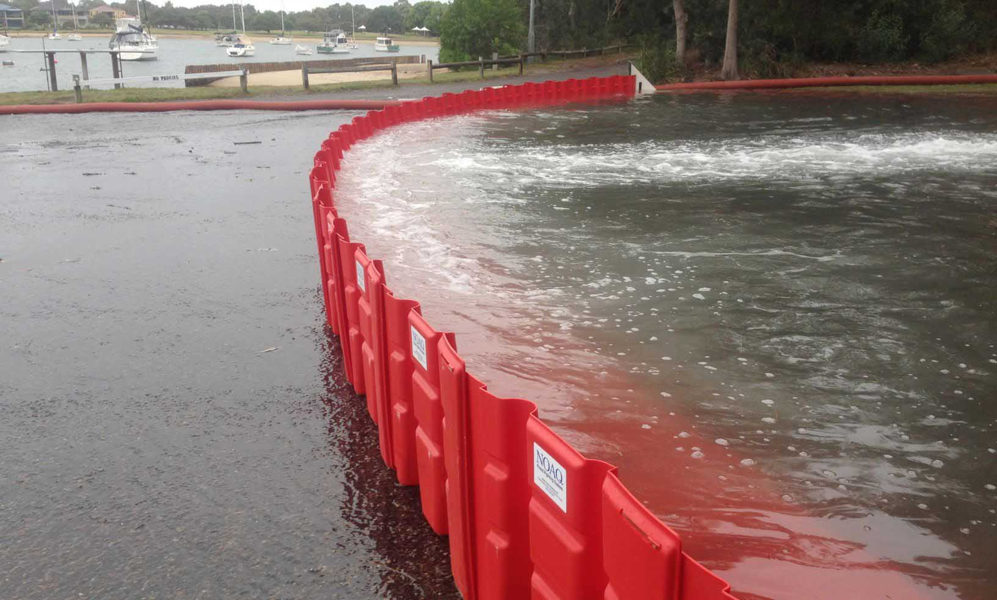
Part IV – How can we plan with natural river processes?

Slide 19
Explore how communities were affected by floods
Use the “USGS Flood Inundation Mapper” (https://fim.wim.usgs.gov/fim/) and identify what the community in Iowa City should do for future planning.
→ See the handout for the full exercise!

